Slide 1
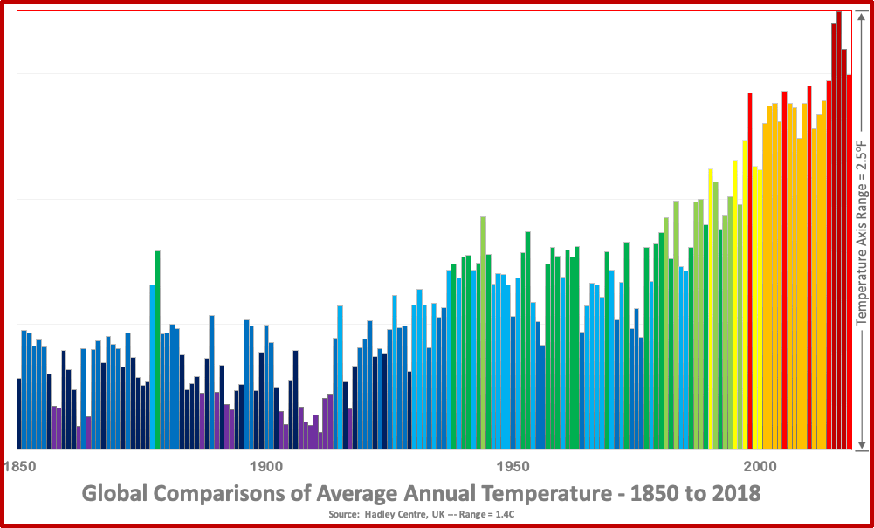
Public Issues Forums:
Climate Crisis Series
. . . raise awareness and private/public action to reduce carbon emissions and build resilient communities through non-partisan leadership

Slide 2
Climate Crisis Series
Forum 1: Why Climate Change
Is a Public Health Emergency

Slide 3
Climate Crisis Series
Future Forums:
Nov: The Role of Local Governments
Feb: Agricultural Impacts/Solutions
April: Our Water

Slide 4
Climate Crisis Series
What does our logo show?
What does our logo show?
Yearly Global Temperatures from 1850 to 2018
Vertical scale: 2.5ºF (1.4ºC) in 0.25ºF steps
Blues are colder
Reds are warmer

Slide 5
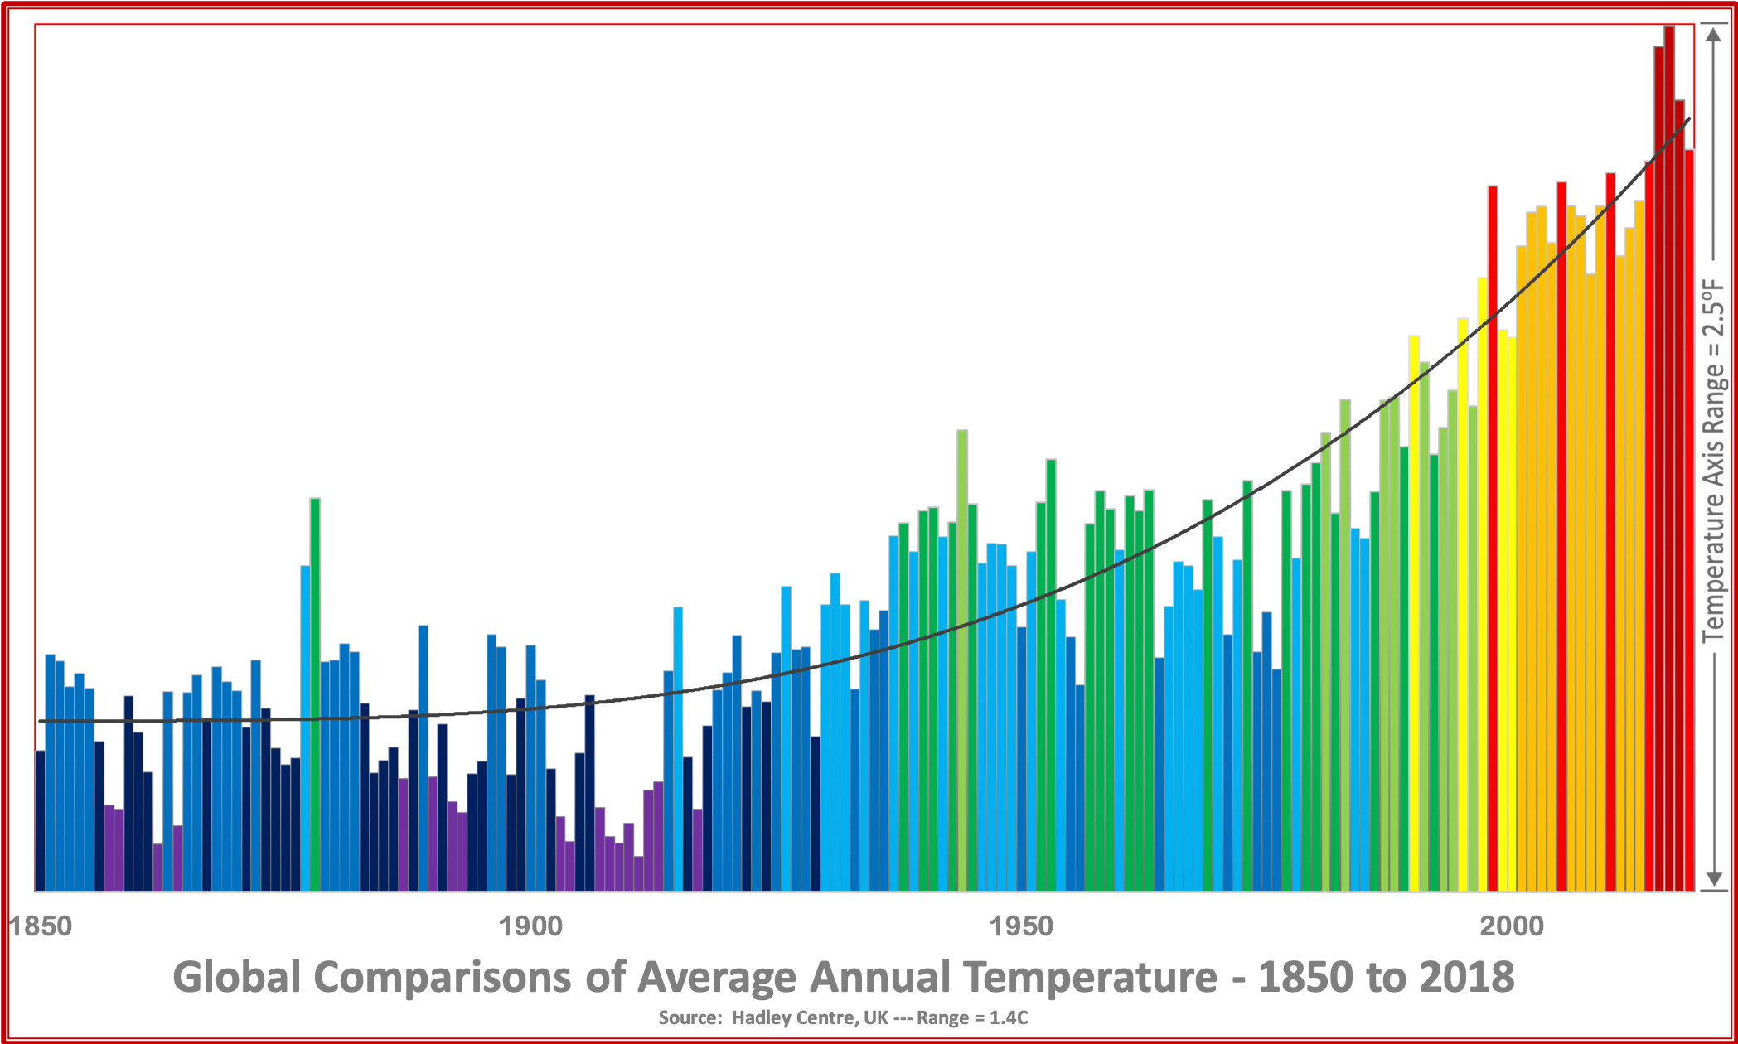
Climate Crisis Series
What does our logo show?
Yearly Global Temperatures from 1850 to 2018
Vertical scale: 2.5ºF (1.4ºC) in 0.25ºF steps
Blues are colder
Reds are warmer
What does our logo show?
What caused this warming?

Slide 6
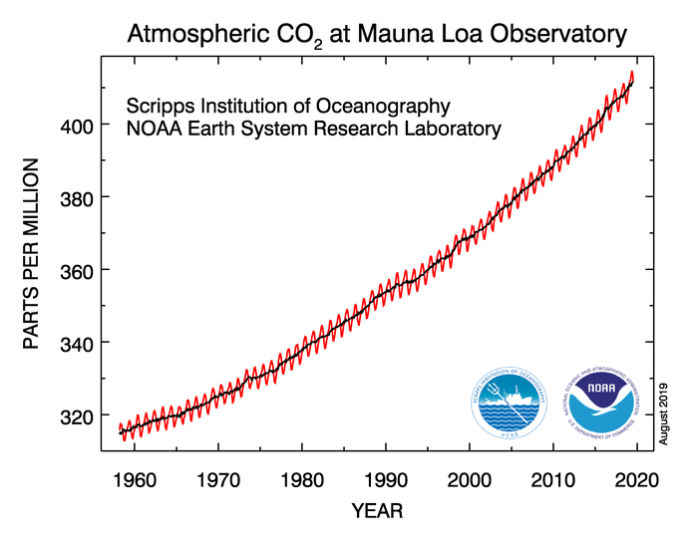
Climate Crisis Series
Increases in CO₂ have been documented since 1958.
And the rate of increase has been accelerating

Slide 7
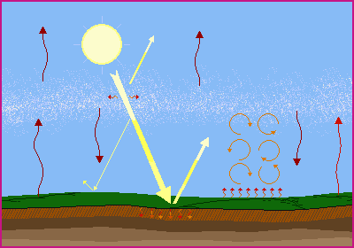
Climate Crisis Series
What in the Atmosphere Causes “CO₂ Warming”?
Life on Earth has evolved with a careful atmosphere balance of:
Incoming Solar Radiation (primarily visible) from a hot sun
Outgoing Infrared Radiation (IR) from the earth’s warm surface and atmosphere
This “Atmosphere Radiator” helps to keep our surface temperatures livable
Graphics from UCAR COMET Program

Slide 8
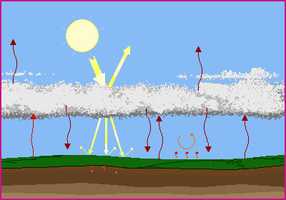
Climate Crisis Series
What in the Atmosphere Causes “CO₂ Warming”?
Increasing certain gases in the
atmosphere that absorb
IR radiation from Earth:
Reduces loss of heat to space and
Increases reheating of the earth’s surface by the atmosphere.
Graphics from UCAR COMET Program

Slide 9
Climate Crisis Series
What in the Atmosphere Causes “CO₂ Warming”?
CO₂ warms the atmosphere by absorbing IR radiation
But a warmer atmosphere can also hold more Water Vapor
Because Water Vapor is another a very good absorber of outgoing IR radiation, overall warming can be enhanced even further and . . .
Graphics from UCAR COMET Program

Slide 10
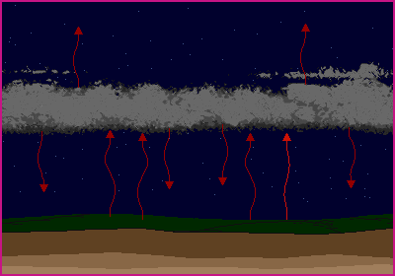
Climate Crisis Series
What in the Atmosphere Causes “CO₂ Warming”?
During daytime, the sun still provides the vast majority of heat to the earth’s surface.
At night, when the only source of heat is the atmosphere, the combined effects of the increased CO₂ and water vapor dominate.
To see what’s happening closer to home,
let’s look at the Northern Hemisphere
Daily Low Temperatures have risen more than Highs
Graphics from UCAR COMET Program

Slide 11
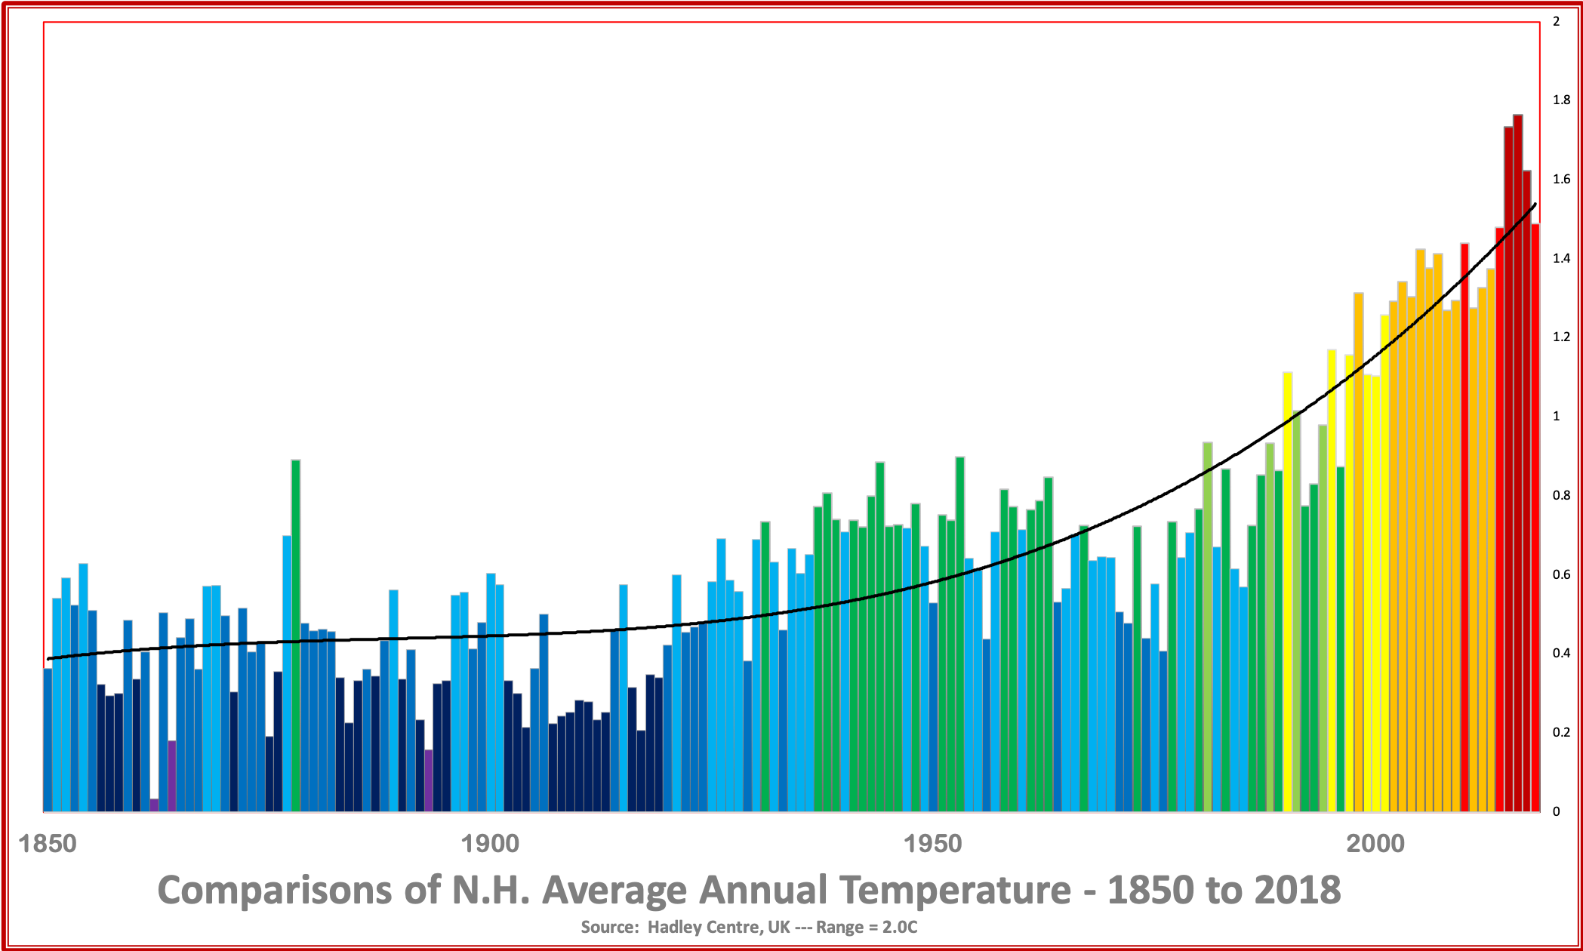
Climate Crisis Series
Extratropical Northern Hemisphere Results
Compared to Globe:
Very similar trends, but most heating after 1940.
Warming greater by 20% (2.0º vs 1.7ºF).
Range between coldest and warmest years also increased.
Likely due to larger % of land area.
3.6ºF
Can we identify specific events?

Slide 12
Climate Crisis Series
1958 .
I.G.Y. .
Start of .
CO₂ record
Critical data to form scientific basis
~1975
Scientific community concern about CO₂ increases
1990
First
IPCC
report
Robust climate models
Can we identify
specific events?
Can we identify
specific events?
Not well at this large scale.
However, some important dates in Climate Change Discovery deserve note.
3.6ºF
1970
Satellite
records
begin
1932-39
Dust
Bowl
What will we discuss next time?

Slide 13
Climate Crisis Series
“Climate Science Primers” at future series events will ask the questions:
What are some more local consequences of climate change?
Why should we have confidence in climate forecasts?
What parameters besides temperature have changed here
during the past century?
3.6ºF

