Slide 1
UN Intergovernmental Panel on Climate Change (IPCC)
6000 scientific references cited
91 authors and review editors / 40 countries
Assess the current status of climate change and predictions including scientific, technical, and socio-economic impacts

Slide 2
-to keep the rise in global temperatures below 1.5C -emissions of carbon dioxide would have to be cut by 45% by 2030
12 Years from
October 2018

Slide 4
If 45% carbon cut by 2030 Plans really need to be on the table by the end of 2020:
It does not mean we have 12 years BEFORE we have to act.
It does not means that we have 12 years to completely decarbonize
And it does not mean that the fight is over if we fail to reach our target in 12 years.

Slide 5
Political Will – Adds to Public Health Emergency
Paris Agreement Withdrawal 2017
Easing of EPA power plant emission standards (Affordable Clean Energy Rule) June 2019
Opening up 16 million acres of Tongass National Forest in Alaska for logging and drilling August 2019
Burning Amazon for grazing August 2019
Proposed rollback on methane leak regulation
for oil and gas industry August 2019

Slide 6
Clean Power Plan (2015) vs Affordable Clean Energy Rule (June 2019)
Limit carbon from power plants
Reduce CO2 emissions by 32% 2005 levels by 2030
Avoid 3600 premature deaths, 90,000 fewer asthma attacks, prevent 300,000 missed work/school days
Save $85 per household on energy bill
No emissions reduction / states decide
12X higher CO2 emissions by 2028
Increase up to 1400 premature deaths annually by 2030, 48,000 new cases of exacerbated asthma, 21,000 new missed school days annually

Slide 7
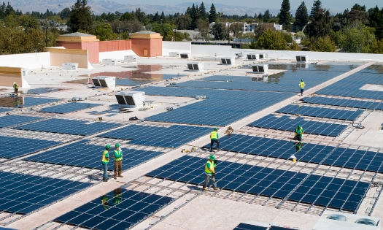
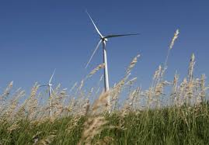
Setting the intention (Namaste)
Germany increased renewables from 6.3% in 2000 to 25% in 2012
Goal to cut emissions 40% by 2020
(2018 Reached!)
New goal 55-65% by 2030
Notes:
List health effects of Coal!
Ending particle pollution from existing coal plants is expected to save 24,000 lives and prevent nearly 40,000 heart attacks, over 20,000 each hospital admissions and ER visits, and over 3 million lost workdays. Ending mercury pollution from coal fired plants- protect 300,000 newborns/ year from risk of brain damage and learning disabilities. Total monetized impact of coal is more than $100 billion.
$100 billion or million?

Slide 8
Renewable Energy Future of Wisconsin
Wisconsin spends over $14 billion fossil fuels/year in 2016
(COWS – Abel study)
Solar predicted to increase from 100 MW to 5000 MW in 5 years (300-megawatt Badger Hollow project in Iowa County and the 150-megawatt Two Creeks project along Lake Michigan south of Kewaunee)
2000 MW of wind proposed
(RENEW Wisconsin)

Slide 9
Wisconsin – Renewable Energy Commitments
Governor Evers proposal 100% carbon-free electricity by 2050
9 other states/territories committed
Municipalities with 100 % clean energy goals
– Eau Claire, LaCrosse, Madison, Middleton, Monona
American Family, Gundersen, Edgerton hospital,
Advocate Aurora Health

Slide 10
Wisconsin Department of Health Services Climate and Health Program

Slide 11
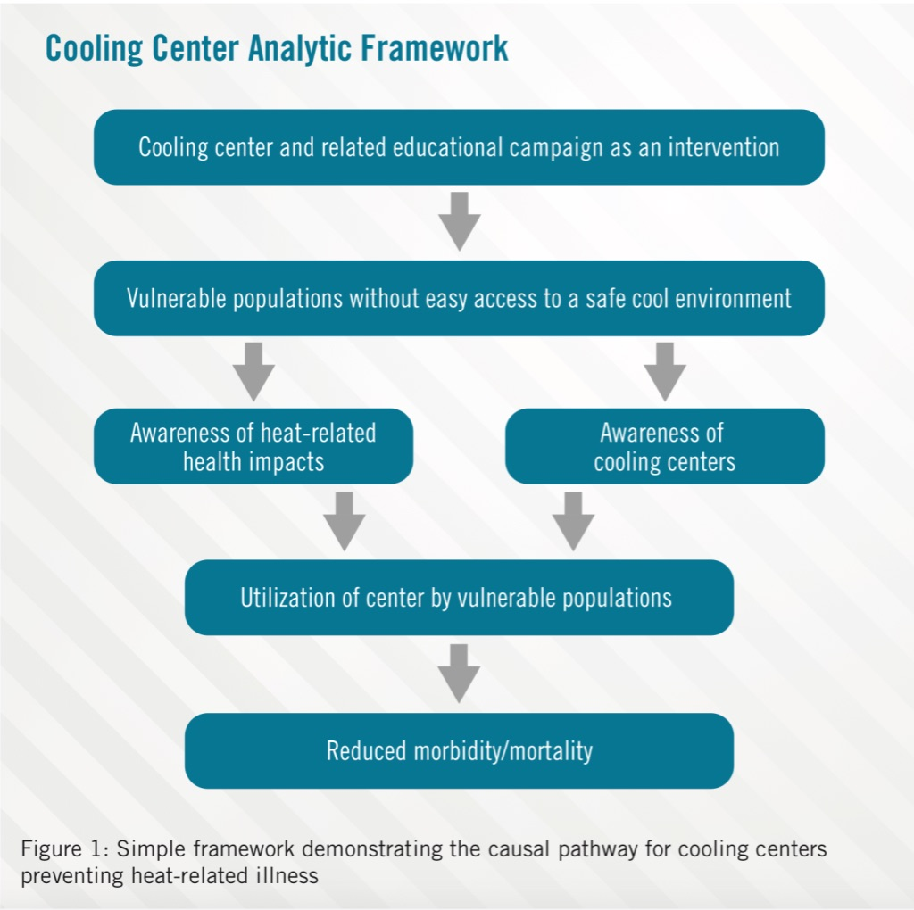
2019 Heat Wave – Adaptation, Cooling Centers

Slide 12
Wisconsin Health Professionals for Climate Action

Slide 13
PRIORITY ACTIONS
CLIMATE ACTION FOR HEALTH
Meet and strengthen the commitments the U.S. made under the Paris Climate Agreement.
Transition rapidly away from the use of coal, oil and natural gas to clean, safe, and renewable
energy and energy efficiency.
3. Emphasize active transportation in the transition to zero-carbon transportation systems.
4. Promote healthy, sustainable and resilient farms and food systems, forests, and natural lands.
5. Ensure that all U.S. residents have access to safe and affordable drinking water and a sustainable water supply.
6.Invest in policies that support a just transition for workers and communities adversely impacted by climate change and the transition to a low-carbon economy.
HEALTH ACTION FOR CLIMATE
7. Engage the health sector voice in the call for climate action. 8. Incorporate climate solutions into all health care and public health systems.
9. Build resilient communities in the face of climate change.
FINANCING CLIMATE ACTION FOR HEALTH AND HEALTH ACTION FOR CLIMATE
10. Invest in climate and health.
Together, these ten policy recommendations provide a roadmap to develop coordinated strategies for simultaneously tackling climate change, health, and equity. Climate change is a public health emergency. We call on our nation’s leaders to act now by mobilizing climate actions for our health, and health actions for our climate. With the right policies and investments today, we have the opportunity to realize our vision of healthy people in healthy places on a healthy planet.

Slide 14
What you can do
Personal – some impact
Transportation – bike, bus, walk
Energy efficiency – insulation, lights off, solar, wind, geothermal
Food - less meat, less palm oil, vegan diet?

Slide 15
Opportunities- Transportation
Eliminating 5 mile auto trips in great Madison and Milwaukee area could save 21 lives/yr and $105 million
Replacing 50% of those eliminated auto trips with bicycles on the 124 best weather days/yr would save 51 lives/yr and $279 million/yr from avoided mortality and reduced healthcare costs
Notes:
Biking as a regular form of transportation has significant potential to increase regular physical activity, reduce obesity, and improve air quality. A recent study estimated the greater Madison and Milwaukee area could see significant economic and health benefits from replacing short car trips with bike trips.⁶ Eliminating automobile trips less than 8 km (5 miles) round trip would reduce air pollution, each year saving an average of 21 lives and $105 million.⁶ Replacing 50% of those eliminated automobiles trips with bicycle trips on the 124 best weather days of the year would save 51 lives/year and an average of $279 million per year from avoided mortality and reduced healthcare costs.⁶
^{Madison is 9 9 12 65}

Slide 16
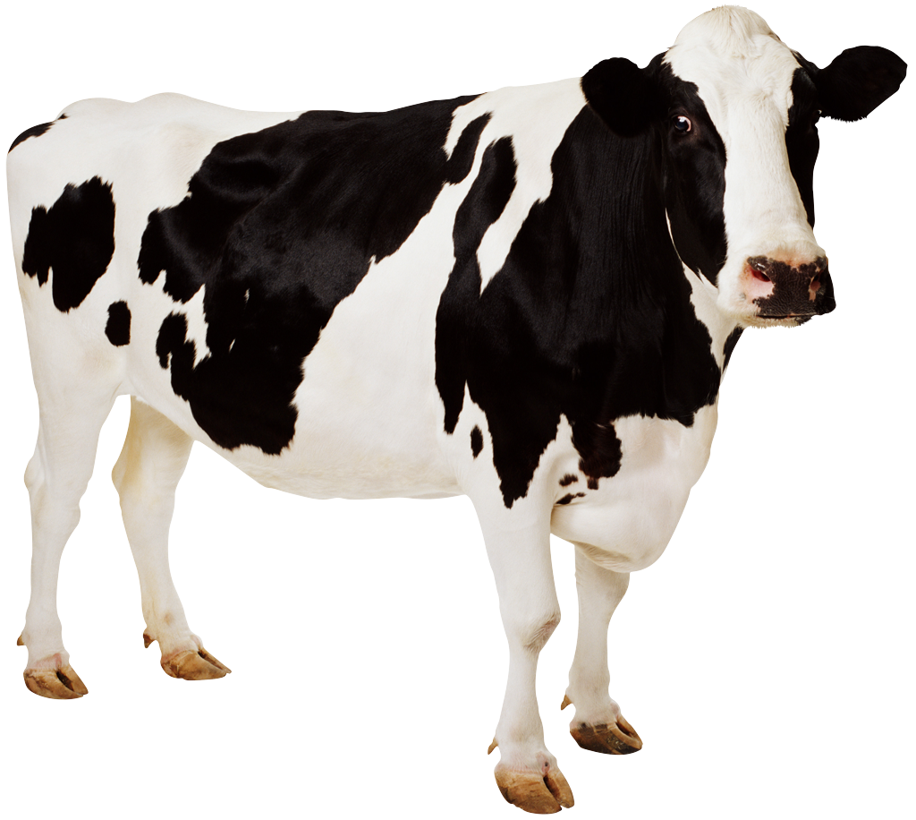
LESS STEAK
Agricultural activity (esp livestock production) accounts for ≈1/5 total greenhouse gas emissions
Goal: reduce meat (and dairy)
Consumption from
100 g to 90 g / person / day
< 50 g coming from ruminants
Food, livestock production, energy, climate change, and health AJ McMichael et al Lancet 13 Sept 2007

Slide 17
Diet and Climate Change
DIET
Meat 100 gm
Meat 50 gm
Vegetarian
Vegan
CO2 pollution
16 lbs/d
10.3 lbs/d
8.4 lbs/d
6.5 lbs/d
Dietary greenhouse gas emissions of meat/fish-eaters, vegetarians, and vegans in the UK P Scarborough et al Climate Change 11 June 2014

Slide 18
What you can do
Active
Awareness – watch, read
Letters to the editor
Engagement with at risk populations
Vote for less dependence on fossil fuels
Engage stakeholders – sustainable energy
Engage employers in divestment
Notes:
Show book, magazines

Slide 19
Thank you!
cmgerva@gmail.com

