Slide 1
WHY CLIMATE CHANGE IS A PUBLIC HEALTH EMERGENCY
Claire Gervais, MD, Clinical Associate Professor
UW School of Medicine and Public Health
Wisconsin Environmental Health Network
Wisconsin Health Professionals for Climate Action
Sept 4, 2019 League of Women Voters

Slide 2
Objectives
Understand why climate change is a public health emergency
Public health effects / populations at risk
Role of policy makers
What can we do? (speak up)

Slide 3
Public Health Emergency

Slide 4
Lancet Countdown: Tracking Progress on Health and Climate Change
Unmitigated climate change would undermine 50 years of public health gains
Responding to climate changes could be the “greatest global health opportunity of the 21st century”

Slide 5
8 Reasons: PUBLIC HEALTH EMERGENCY Scientific American
Frequency, intensity, duration of heatwaves, droughts, wildfires, floods, storms – (2.52 million deaths 1980-2013)
As average temps rise, so will heat-related disorders – (over 20,000 sugarcane workers died from chronic kidney disease in Central America and southern Mexico over 2 decades)
Climate change increases air pollution – (increased stagnation events, ozone , wildfires, wind-blown dust / pollution)
CO2 increase decreases human cognitive performance – (currently 410 ppm, projected as 1000 ppm by 2100)

Slide 6
8 Reasons: PUBLIC HEALTH EMERGENCY
Increased vector, food, and water-borne diseases – (West Nile invasion in North America, malaria spread to East African Highlands, increases in cholera / diarrheal diseases)
Food and nutrition security – (increased food demand 14%/decade, decreased production 1-2%/decade)
Mass migrations / increased violence – (military experts warn climate impacts are “threat multipliers” causing civil unrest, 20-120 million people could be displaced by 2050)
Mental health – (PTSD, depression, drug/ETOH abuse, suicide, abuse)
Climate Change Is a Public Health Emergency, Ploy Achakulwisut 1/23/19 Scientific American

Slide 7
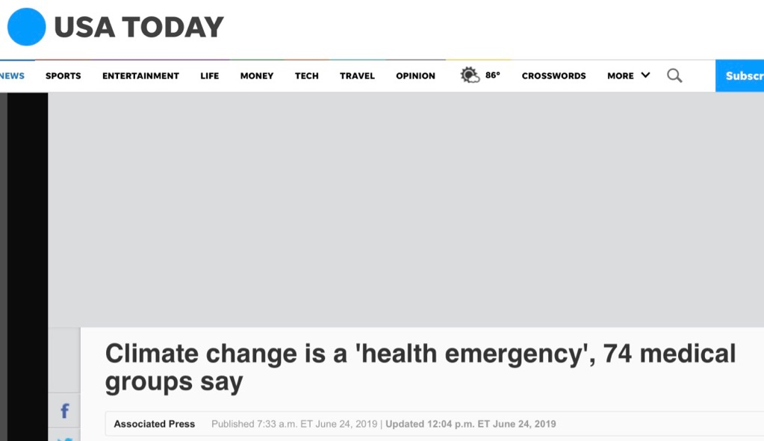
Medical groups

Slide 9
Understanding Climate Change
97% or more of actively publishing climate scientists agree:
The earth is warming.
We are causing it.
It’s already harming our health, but poses even more significant risks.

Slide 10
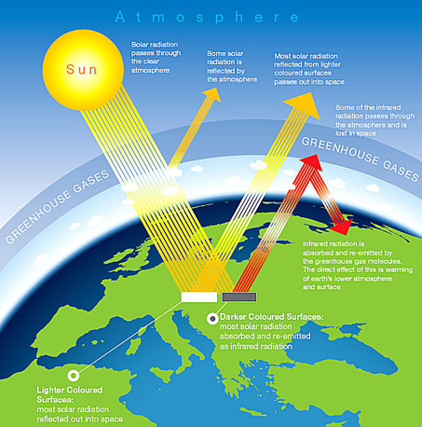

Slide 12
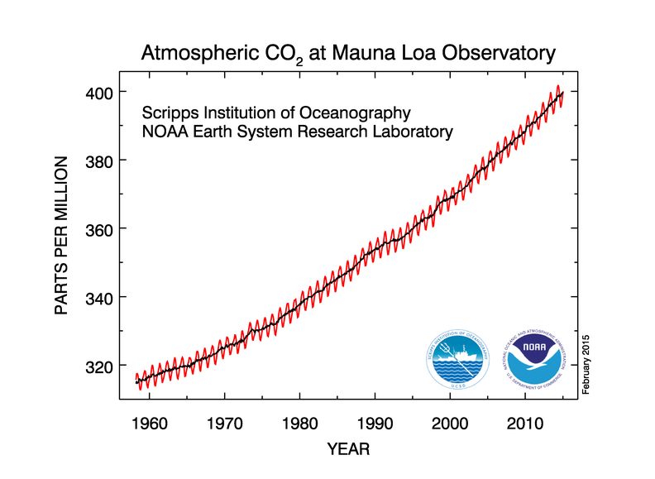
How do we know how much CO is in the atmosphere?
Notes:
NOAA collecting data since the 1950’s (National Oceanic and Atmospheric Administration)

Slide 13
Business as usual: 4-6°C
Danger threshold: 2°C
Notes:
Point out:
Target CO2 needs to be at 350 ppm or lower – James Hansen data, paleoclimate research shows that the main cause of the cooling trend and glaciation was decreased CO2 levels 450 +/- 100 ppm that began 50 milllion yrs ago; we live in the Holocene – humans have adapted to this
12k years of human civilization. 1750 @ 280 ppm.
395 ppm, warmed 0.8C, guaranteed 1.6,
2C (3.6 F) threshold. 450 ppm 50/50 trigger tipping points. (peat bogs, permafrost, amazon etc… guarantee 12-20C irreversible). Can allow ~500 GtC over next century.
Where we’re headed: Despite recession, GHG emissions rising faster than worst case scenario. Headed for 4-6C warming. Fossil fuel companies current stock values based on their intention to burn known reserves of 2700 GtC.

Slide 16
Notes:
Mental health impacts of extreme weather events may be more longstanding than other impacts

Slide 17
Populations at Risk
Urban poor
Older adults
Young children
Traditional societies, subsistence farmers
Coastal populations
Rural populations
Outdoor workers
No access to air conditioning

Slide 18
Sea Level Rise
Notes:
NC’s Outer Banks (200 mile island chain) – threatening houses, this one being moved to higher ground. In the last 150 yrs, beach has receded 2500 ft. That portion of the island has narrowed to 25% of its original width. Highway has buckled, closed. Damaged in Hurricane Sandy.

Slide 19
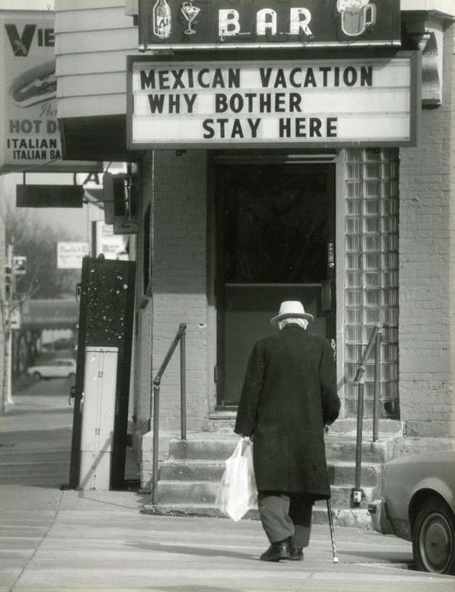
Flooding and Health
Evacuation
Crypto outbreak Milwaukee 2003
Notes:
Cryptosporidiosis outbreak during a month of record rainfall. Photo is Milwaukee estuary 1980.
Flood waters may contain over 100 types of disease causing germs as well as farm waste, toxic chemicals, and raw sewage that contaminates homes and drinking water.
COMBINED SEWER OUTFLOW : When same sewer system carries sewage and runoff. Over 700 cities have CSOs, including NYC, Washington DC, and other major cities. Overall about 40 million Americans live in towns and cities with CSO. In NYC it only takes 1/20 of an inch of rain to cause sewage overflow. More than half of drinking water contamination cases in urban watersheds occur during storm events.
Warmer temperatures cause increased evaporation of surface waters into clouds, leading to more storms and heavy rain. heavy rainfall has increased by 20%.

Slide 20
Flooding – Wisconsin 2019 and Trends
Loss of home / possessions
National Oceanic and Atmospheric administration

Slide 21
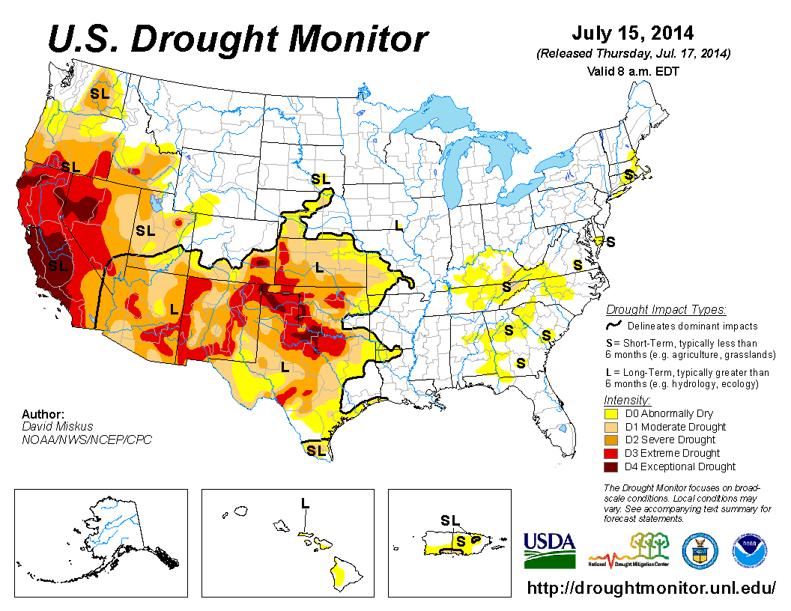
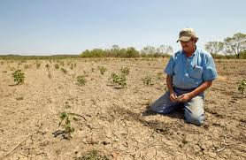
Drought and food insecurity
Notes:
More than half CA crop value from fruit and tree nuts
Produces 80% of world’s almonds (can’t handle drought)

Slide 22
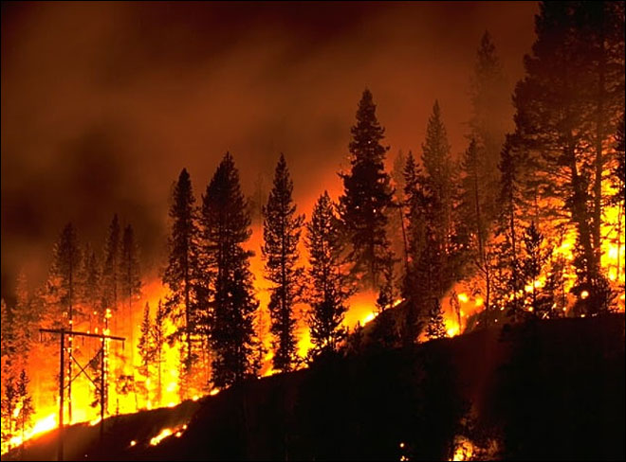
Drought, Wildfires
Notes:
Sign near Prineville, OR. Hwy 26 closed due to forest fires last year. CA, OR, and WA still experiencing many wildfires yearly. Also MT, ID, UT, NV

Slide 23
Air quality - wildfires
Notes:
Air quality, particulate matter – could feel it in my throat, imagine asthma

Slide 24
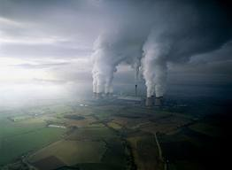
What is Smog?
Ground ozone
Fine particles
Notes:
Ozone, fine particles. Inhaling fine particles aggravates heart and lung disease, asthma, decreased lung function growth in children. Source – power plants, gasoline/diesel engines, wood combustion, high temp industrial processes – smelters, steel mills, forest fires.

Slide 25
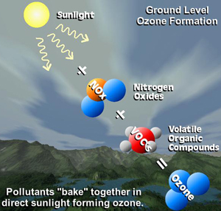
Ground Ozone
Pollutants from car exhaust,
power plants, factories
Peaks in hot summer months
Damage to lungs
Heart arrhythmias
Low birth weight
Notes:
Researchers looked at 48 US cities and found nearly 4,000 early deaths per year for every 10 ppb increase in ozone in summer months, at levels still considered safe

Slide 26
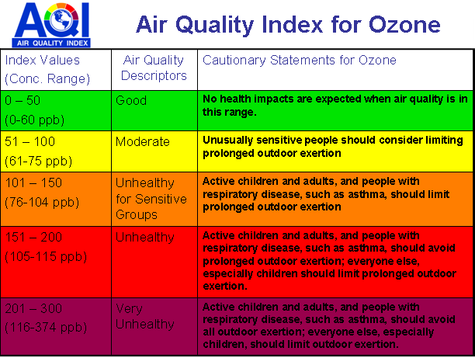
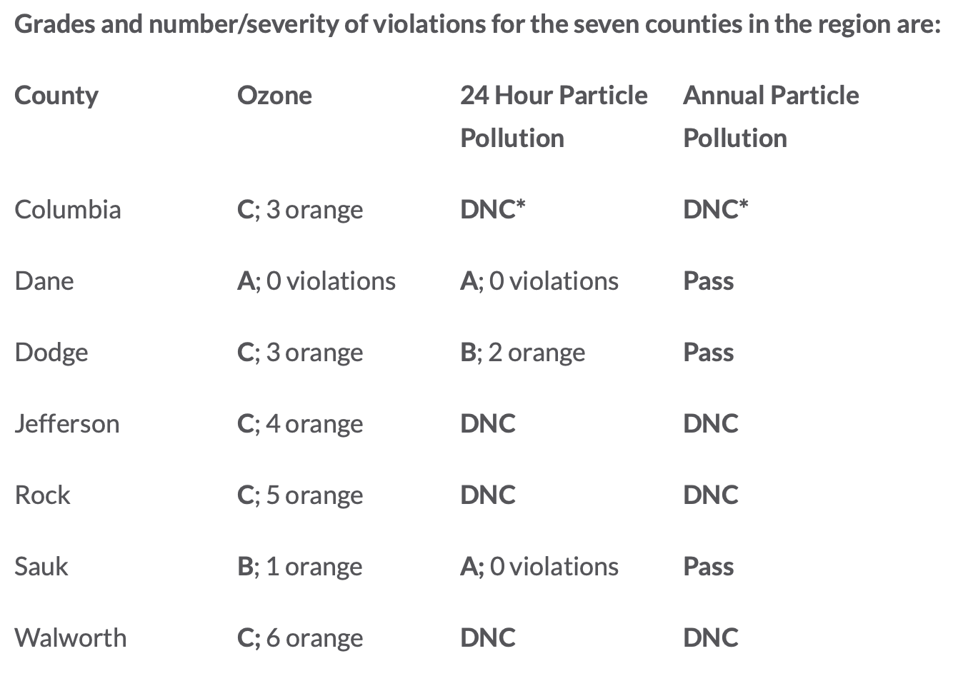
Wisconsin Air Quality
– American Lung Association Report 2019
Notes:
If emissions of air pollutant remain fixed at todays levels until 2050, warming from climate change alone could increase the number of Red Ozone Alert Days by 68% in the 50 largest eastern US Cities.
40% of US pop in areas with unsafe levels, which in summer urban areas can be in the 60-200 range Longer term exposure causes permanent lung damage.

Slide 27
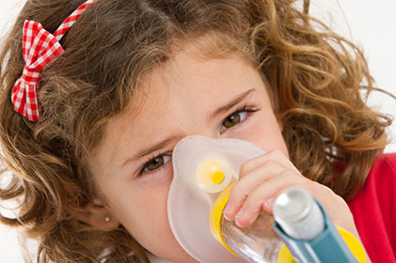
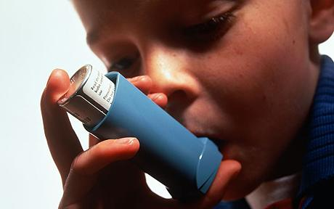
Asthma
Doubled since 1980
Asthma 3X more
likely for active kids
in high ozone communities
Notes:
Children are most vulnerable. Kids playing three or more team sports in communities with high daytime ozone concentrations are three times more likely to develop asthma than children playing no sports. Asthma rates have doubled since 1980, with highest rates in areas with high ozone.

Slide 28
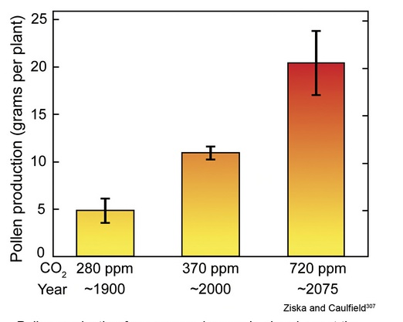
Asthma and respiratory disease - pollen
Pollen
Notes:
Pollen increases with CO2, acts as fertilizer. First 2 bars on graph are real life historical info and last bar is projected pollen production.

Slide 29
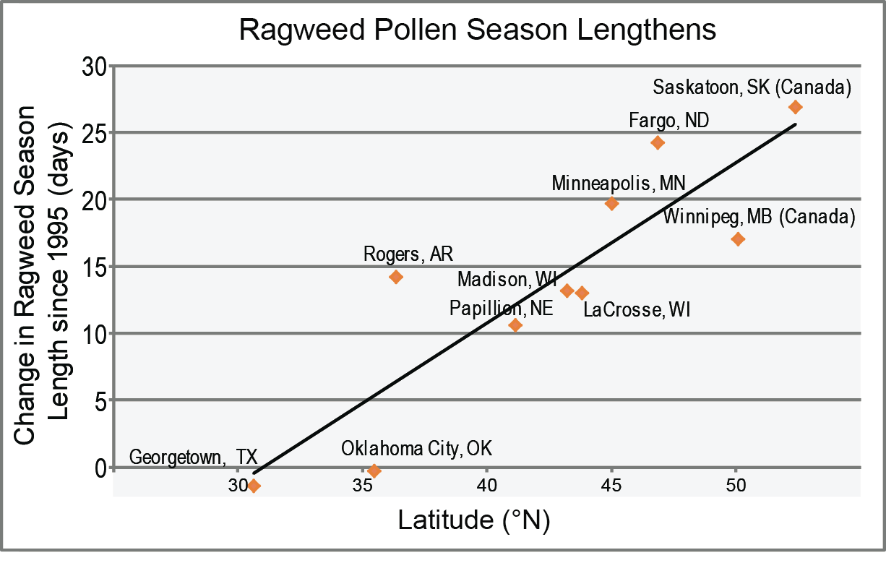
Ragweed pollen season increasing

Slide 30
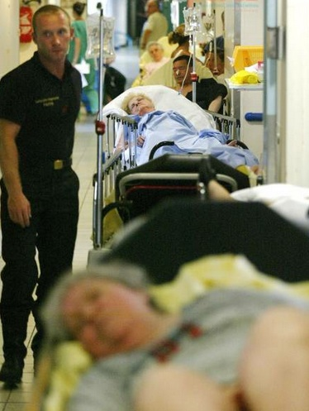
Heat Waves
[National Oceanic and Atmospheric Administration (NOAA) Climate.gov]
2010 Russia 55,000 deaths /2003 Europe 50,000 deaths
8X more days of excessive heat by the end of the century
Longer, more frequent, more intense
Notes:
Children, elderly, and those on diuretics, psychiatric meds, work outdoors most vulnerable. Urban heat islands, raise city temps 9 deg F higher than suburbs. Heatwave 2003 europe 50,000 excess deaths in 11 days. CA 2006, 2 weeks: 600 deaths, 1600 hospitalizations, 16,000 ER visits. By the end of the century there will be 8 times more days of excessive heat and triple the number of heat related deaths. Explain image (high emission scenario, which is now business as usual). Heat waves more frequent, intense, and longer. Show predicated increased duration and frequency of heat waves from 1970-2000 vs 2040-2070.

Slide 31
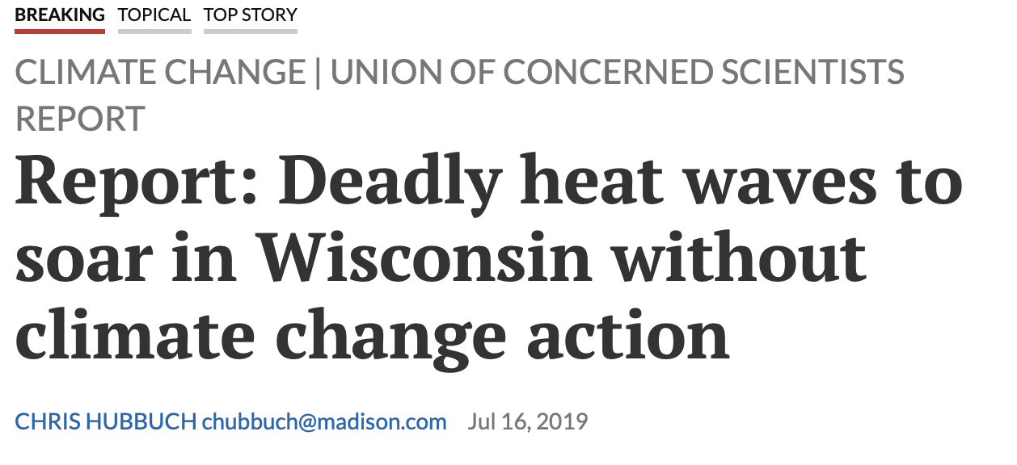
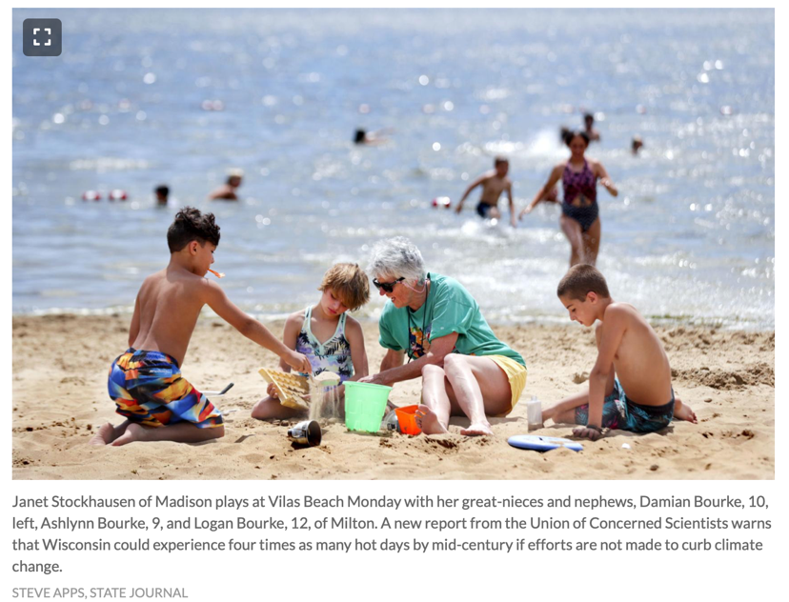
UCS report:
4X as many hot days by 2050
if no efforts to curb climate change
(Wisconsin projected temp rise 4-5ºF by 2055)

Slide 32
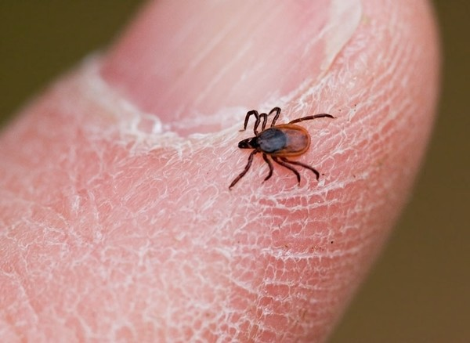
Vector borne diseases
Zika
Lyme disease
Dengue fever
Chagas disease
Chikungunya
Notes:
Other vector borne diseases like lyme disease and dengue fever are spreading as well. Lyme is expanding northwards. 3 fold increase in suitable habitat.

Slide 33
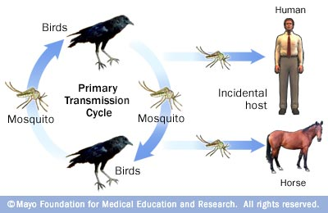
Vector borne disease
Notes:
Fevers, rash, abdominal pain, nausea, vomiting, muscle aches, and headaches. She is disoriented, has difficulty speaking and weakness in her arms and legs. A brain scan is normal.
Dead crow in her yard

Slide 34
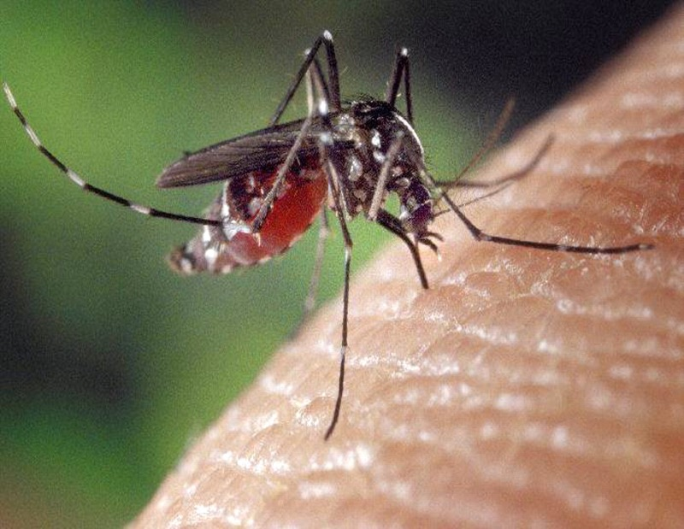
West Nile Encephalitis
Increased temp
and rainfall
increases
breeding season
Increased viral
replication
Notes:
WNV causes encephalitis, inflammation of the brain. There is no effective treatment. in 4 years went from less than 100 to over 10,000 cases. Dr. Jonathan Soverow and his collaborators matched more than 16,000 confirmed West Nile cases in 17 states to local weather data and found that warmer temperatures and rainfall contributed to the rapid spread of WNV. Warmer temperatures extend the length of the mosquito breeding season and decrease the amount of time it takes mosquitoes to grow to their adult, biting stage. Increasing temperature also speeds multiplication of the virus within insects, so mosquitoes in warmer climates carry more virus, making them more likely to infect humans. Increased rainfall was also correlated with higher rates of West Nile Virus infection. heavy rainstorm increased infection rates by 33%, pools of water in which mosquitoes can breed and increase humidity, which stimulates mosquitoes to bite and breed. Thus in a warmer climate there are more mosquitoes, with more virus, who are more likely to bite.

Slide 35
Zika

Slide 36
Effects of Zika
Exposure in pregnancy causes microcephaly
Limited treatment options
No vaccine

Slide 37
Oil Pipelines – since 1987
3300 crude oil/natural gas leaks/ruptures
80 people killed
389 people injured
$2.8 billion in damages
Toxic chemicals in soil, water, air

Slide 38
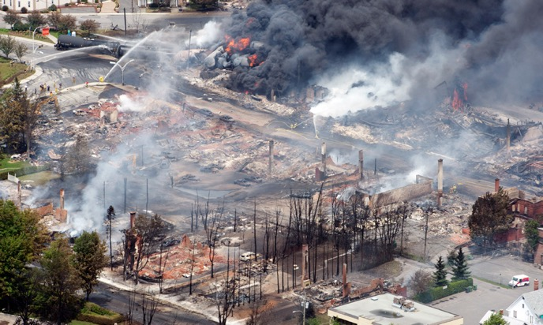
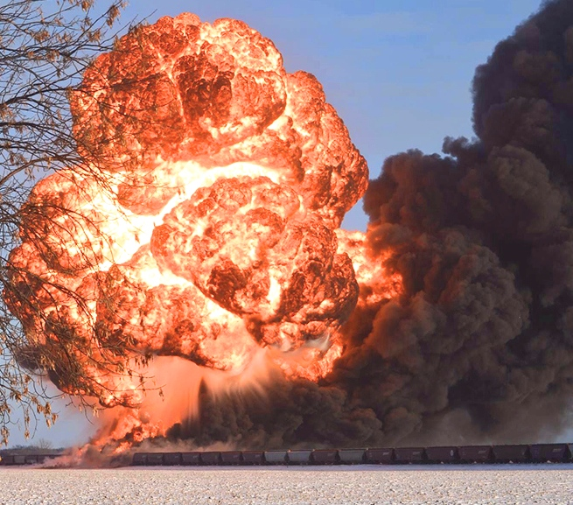
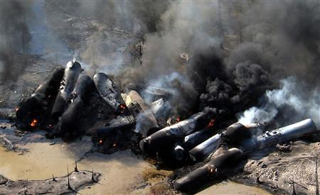
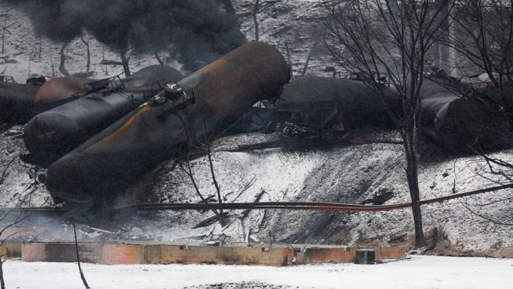
Lac- Megantic, Quebec 47 dead June 2013
Casselton, ND
December 2013
Aliceville, Alabama November 2013
Mount Carbon, West Virginia February 2015

Slide 39
